Slide 1
MEDICAL TOURISM IN
MURMANSK REGION
HOW TO GET MEDICAL CARE IN MURMANSK REGION

Slide 2
2
CONTENTS
The treatment in Murmansk region...3-6
I stage: choice of medical organization in Murmansk region..7-9
II stage: sending a request for treatment to a medical organization………………………………………………………………..10-11
III stage: accommodation and transport............................................12-15
IV stage: visa application……………………………..……………….16-20
V stage: Welcome to Russia! .....................................................21-22
Contacts............................................................................................23
Materials prepared by
THE COORDINATING CENTER OF EXPORT OF MEDICAL SERVICES OF FSBI "TSNIIOIZ" RUSSIAN MINISTRY OF HEALTH.

Slide 3
3
The treatment in Murmansk region

Slide 4
4
The treatment in Murmansk region is:
HIGH
QUALITY
BEST DOCTORS
AFFORDABLE PRICE
ACQUAINTANCE
WITH REGION’S CULTURE
High quality medical care that meets international standards
Qualified medical specialists
with international practice
Competitive cost of medical services of all profiles
You will meet
with the sights of the country and national traditions

Slide 5
5
PROVISION OF MEDICAL CARE
You can get medical care on an outpatient and inpatient basis In the Russian Federation.
Assistance in the selection of treatment conditions for the patient is provided by a medical organization in accordance with the request of the patient.
OUTPATIENT CARE
INPATIENT CARE
PASS THE EXAMINATION
(CHECK-UP) IN 1-2 DAYS
DURING YOUR TOURIST TRIP
IN RUSSIA
CHOOSE A MEDICAL ORGANIZATION BY YOUR PROFILE AND COME TO
TO RUSSIA FOR PLANNED HOSPITALIZATION
LEARN MORE ON THE WEBSITE OF THE CHOSEN MEDICAL ORGANIZATION
LEARN MORE ON THE WEBSITE OF THE CHOSEN MEDICAL ORGANIZATION

Slide 6
6
HOW TO GET MEDICAL CARE IN MURMANSK REGION
I stage:
Choose a medical organization
II stage:
Contact
with a medical organization
for confirmation
III stage:
Choose type of accommodation
and transport
IV stage:
Apply for a visa
V stage:
Welcome to Russia!

Slide 7
7
I stage
CHOOSE A MEDICAL ORGANIZATION ACCORDING TO YOUR MEDICAL PROFILE

Slide 8
8
PROFILES OF HEALTH CARE
AND MEDICAL CENTERS
MURMAN REGION
CARDIOLOGY
TRAUMATOLOGY
AND ORTHOPEDICS
GYNECOLOGY
AND BIRTH CARE
-------------------------------------------------------
Murmansk Regional Clinical Hospital named after P.A. Bayandin https://mokb51.ru/
-------------------------------------------------------
Murmansk Regional Clinical multidisciplinary center
https://bsmp51.ru/
-------------------------------------------------------
CHILDREN'S HEALTH
-----------------------------------------------------------
Murmansk Regional Clinical Hospital named after P.A. Bayandin https://mokb51.ru/
----------------------------------------------------Мурманск
Murmansk Regional Clinical multidisciplinary center https://bsmp51.ru/
-----------------------------------------------------------
---------------------------------------------------------
Murmansk Regional Clinical multidisciplinary center https://bsmp51.ru/
---------------------------------------------------------
Murmansk Regional Children's Clinical Hospital mdgb@com.mels.ru
-----------------------------------------------
OPHTHALMOLOGY
-----------------------------------------------------------
Murmansk Regional Clinical Hospital named after P.A. Bayandin https://mokb51.ru/
---------------------------------------------------------
Murmansk Regional Clinical multidisciplinary center https://bsmp51.ru/
------------------------------------------------------------------
NEUROLOGY
AND NEUROSURGERY
--------------------------------------------------------
Murmansk Regional Clinical Hospital named after P.A. Bayandin https://mokb51.ru/
---------------------------------------------------------

Slide 9
9
PROFILES OF HEALTH CARE
AND MEDICAL CENTERS
MURMAN REGION
THERAPY
And professional medicine
REHABILITATION
ENDOCRINOLOGY
-----------------------------------------------------
Murmansk Regional Clinical Hospital named after P.A. Bayandin https://mokb51.ru/
--------------------------------------------
Murmansk Regional Clinical multidisciplinary center
https://bsmp51.ru/
-----------------------------------------------------
-------------------------------------------------------
Murmansk Regional Clinical Hospital named after P.A. Bayandin https://mokb51.ru/
-------------------------------------------------------
Murmansk Regional Clinical multidisciplinary center
https://bsmp51.ru/
----------------------------------------------------------------
-----------------------------------------------------
Murmansk Regional Clinical Hospital named after P.A. Bayandin https://mokb51.ru/
-------------------------------------------------------
Murmansk Regional Clinical multidisciplinary center
https://bsmp51.ru/
-----------------------------------------------------------

Slide 10
10
II stage
CONTACT THE REPRESENTATIVE OF THE MEDICAL ORGANIZATION FOR DETERMINING THE TREATMENT CONDITIONS
AND PREPARATION OF DOCUMENTS FOR VISIT TO RUSSIA

Slide 11
1. GO THE WEBSITE OF THE MEDICAL ORGANIZATION
IN SECTION "MEDICAL TOURISM"
2. READ THE INFORMATION SUBMITTED
3. WRITE YOUR REQUEST FOR THE SPECIFIED E-MAIL
OR CALL ON THE SPECIFIED TELEPHONE NUMBER
4. GET CONFIRMATION FOR TREATMENT AND FOLLOW RECEIVED
FROM A MEDICAL ORGANIZATION TO RECOMMENDATIONS FOR DRAWING UP THE RELATED DOCUMENTATION
11
IN CASE OF ADDITIONAL QUESTIONS, CONTACT THE COORDINATING CENTER OF EXPORT OF MEDICAL SERVICES OF FEDERAL RESEARCH INSTITUTE FOR HEALTH ORGANIZATION AND INFORMATICS OF MINISTRY OF HEALTH OF THE RUSSIAN FEDERATION.
FOR COMMUNICATION, PLEASE GO TO THE CONTACTS SECTION

Slide 12
12
III stage
CHOOSE ACCOMMODATION AND TRANSPORT
FOR A COMFORTABLE STAY IN MURMAN REGION

Slide 13
TRANSPORT
13
If you arrived in Murmansk by plane:
PUBLIC TRANSPORT
DEPARTURE FROM THE AIRPORT. ROUTES AND SCHEDULE murmanbus.ru
Murmansk
Murmansk International Airport
TAXI
USE A TAXI SERVICE IN RUSSIA THROUGH APPLICATIONS AVAILABLE FOR YOUR MOBILE PHONES:
YANDEX. TAXI, АВТОЛИГА.

Slide 14
USEFUL APPLICATIONS
FOR YOUR SMARTPHONE
(FOR IOS AND ANDROID)
14
PUBLIC TRANSPORT
AND RENT A CAR (CAR SHARING)
MAP OF CITIES OF RUSSIA
SIGHTS OF RUSSIA
1. Map of Russian cities: Yandex.Maps
Google maps
2. Off-line maps of cities in Russia:
2GIS
1. City guides:
Triposo
Redigo
2. Restaurant Guides:
TripAdvisor
1. Bus, trolleybus, tram:
Yandex.Transport

Slide 15
15
ACCOMMODATION
IF YOU ARE GOING TO RUSSIA
FOR OUTPATIENT CARE
In the case of outpatient care, you can independently choose a comfortable stay using the following services:
https://www.booking.com/
https://www.tripadvisor.com/
https://www.airbnb.com/
or seek help from a tour operator / assistance organization
IF YOU ARE GOING TO RUSSIA
FOR INPATIENT CARE
You can find out the conditions of your accommodation from the medical organization that you have chosen in accordance with the profile of medical care.
Please contact your healthcare provider in advance regarding accommodation.

Slide 16
16
IV stage
GET A VISA FOR ARRIVAL IN RUSSIA

Slide 17
REGULATORY FRAMEWORK FOR VISAS
FOR FOREIGN CITIZENS
17
In accordance with Article 2 of the Federal Law of July 25, 2002 No. 115-ФЗ On the Legal Status of Foreign Citizens in the Russian Federation, a foreign citizen is an individual who is not a citizen of the Russian Federation and has evidence of the citizenship (nationality) of a foreign state; stateless person - an individual who is not a citizen of the Russian Federation and does not have evidence of the citizenship (nationality) of a foreign state.
In accordance with Article 25.2 of the Federal Law of August 16, 1996 No. 114-ФЗ "On the Procedure for Departure from the Russian Federation and Entry into the Russian Federation" a visa can be single, double and multiple.
In accordance with Article 25.6 of Federal Law of August 16, 1996 No. 114-ФЗ "On the Procedure for Departure from the Russian Federation and Entry into the Russian Federation", depending on the purpose of the foreign citizen's entry into the Russian Federation and the purpose of his stay in the Russian Federation, ordinary visas are divided into private, business, tourist, educational, working, humanitarian and entry visas to the Russian Federation in order to obtain asylum, obtain a temporary residence permit in the Russian Federation or receive Russian citizenship.
Article 25.9.
Upon entering the Russian Federation, a foreign citizen or stateless person is required to receive and fill out a migration card.
The migration card must be delivered (returned) at the checkpoint at the State border of the Russian Federation on departure of a foreign citizen or stateless person from the Russian Federation.
In accordance with Article 18 of Section II in the Russian Federation, depending on the purpose of entry of foreign citizens into the Russian Federation and the purpose of their stay in the Russian Federation, the following categories of visas exist: a) diplomatic, b) official, c) ordinary, d) transit, e) Visa of a temporary resident.

Slide 18
18
VISA TYPE SELECTION AND IDENTIFICATION
OF PURPOSE OF STAY*
* In accordance with the appendix to the joint order of the Ministry of Foreign Affairs of Russia, the Ministry of Internal Affairs of Russia and the Federal Security Service of Russia dated December 27, 2003 No. 19723A / 1048/922
VISA TYPE: TOURIST
PURPOSE OF STAY:
TARGET TOURISM
VISA TYPE: BUSINESS
PURPOSE OF STAY:
TREATMENT
VISA TYPE: PRIVATE
PURPOSE OF STAY:
SPECIAL CASES
VALIDITY:
Up to 30 days
FOR WHOM:
Foreigners arriving with tourist purposes on a specialized tour for medical advice and for medical examination
VALIDITY:
Up to 90 days
FOR WHOM:
Foreigners arriving for treatment, examination, medical consultations at the invitation of a medical institution (except for targeted tourism for the purpose of treatment) and emergency treatment
VALIDITY:
Up to 90 days
FOR WHOM:
Foreigners arriving for emergency treatment or due to a serious illness or death of a close relative

Slide 19
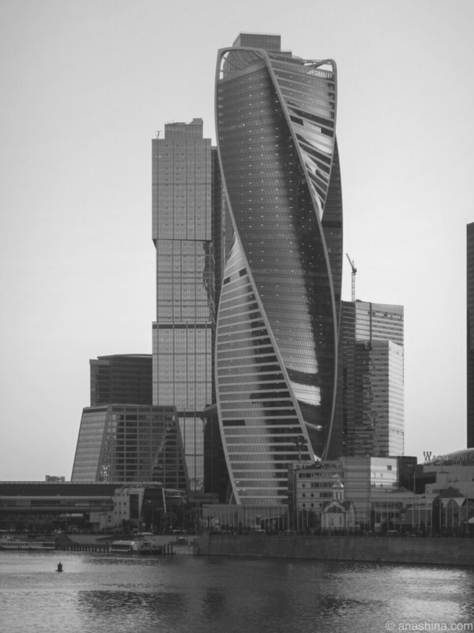
19
HELP WITH PAPERWORK
FOR ENTRANCE TO RUSSIA
APPLICATION FOR ARRIVAL IN RUSSIA
The medical organization that has confirmed the possibility of your treatment can issue you an invitation to enter Russia, as well as resolve the issue of the migration registration.
To clarify the information, please contact your medical organization.
APPLICATION OF THE NECESSARY DOCUMENTATION FOR OBTAINING A VISA BY THIRD PARTIES
If a tour operator or an assistance organization is involved in the issue of your treatment in Russia, then entrust the organization with obtaining documentation for a visa.

Slide 20
20
V stage
WELCOME TO RUSSIA!
USEFUL CONTACTS

Slide 21
21
USEFUL CONTACTS
Federal Migration Service Hotline
Report violations of law and order in the Russian Federation
Single number of
emergency services
112
8 (800) 350 23 69
add. 381
8 (800) 222 74 47

Slide 22
22
OUR CONTACTS
FOR QUESTIONS AND SUGGESTIONS
COORDINATING CENTER
FOR EXPORT OF MEDICAL SERVICES
FEDERAL RESEARCH INSTITUTE FOR HEALTH ORGANIZATION AND INFORMATICS OF MINISTRY OF HEALTH OF THE RUSSIAN FEDERATION
127256, Moskow, Dobrolubova st., 11
EMAIL
OM@ROSMINZDRAV.RU
CONTACT NUMBER
+7 (495) 618-07-92, add. 103
+7 (495) 618-07-92, add. 104

